Slide 1

Faculty of Science & Technology
Jagran School of Computer Application
Internship Project Report Presentation
UNISPHERE
A Full-Stack User Management System & Administrative Command Center
Presented by:
Zuhair Islam Jafri(2023BCAH063)

Slide 2
Outline
Introduction to UniSphere
The Host Organization (Aharnish Infotech)
Internship Objectives & Vision
UniSphere: Core Features (40+ Dynamic Fields)
Technical Stack (PHP 8.2 & MySQL)
System Architecture (3-Tier Model)
Data Logic (Search & Pagination)
Security Framework
System Snapshots
Challenges & Learnings
Conclusion & References

Slide 3
Introduction To UNISPHERE
Developed a high-performance web application designed to manage, track, and optimize complex user records.
Serves as a centralized administrative nerve center that efficiently handles both frontend dynamic UI and backend logic.
Built as a production-ready solution to bridge the gap between academic projects and enterprise software.

Slide 4
HOST ORGANIZATION OVERVIEW
Completed a 3-month intensive industrial training program at Aharnish Infotech Private Limited.
Worked closely with the core development division, gaining deep insights into professional workflows.
Exposed to industry-standard practices including Agile methodologies, peer code reviews, and Git version control.

Slide 5
SYSTEM SCALE & ATTRIBUTES
Engineered to systematically process and map 40+ dynamic data fields across multiple user profiles.
Manages extensive dataset arrays ranging from institutional demographics to real-time administrative logs.
Avoids the limitations of flat databases by utilizing highly indexed relational metadata structures.

Slide 6
SYSTEM ARCHITECTURE (3-TIER)
Presentation Layer: Built with a clean, fully responsive Bootstrap 5.3 UI optimized for extended admin operations.
Application Layer: Uses a robust PHP 8.2 logic engine to process request handlers, validations, and routing.
Data Layer: Utilizes a structured MySQL relational database ensuring absolute transactional integrity.

Slide 7
TECH STACK SELECTION
Frontend: Standardized on HTML5, CSS3, JavaScript (ES6+), and Bootstrap 5.3 framework components.
Backend: Programmed with Core PHP 8.2 for high-speed server-side scripting and seamless session routing.
Database & Dev Env: Managed via MySQL Relational DB, XAMPP local environment, and Visual Studio Code IDE.

Slide 8
CORE FUNCTIONALITIES
Dynamic Record Management: End-to-end CRUD functionality allowing smooth user enrollment and updates.
Analytical Counters: Live calculation metrics displaying real-time summaries of active students, teachers, and projects.
Asset Mapping: Automatic verification scripts designed to handle document attachments and profile pictures.

Slide 9
ADVANCED SEARCH DATA LOGIC
Implemented optimized SQL LIKE query operators to execute rapid, multi-attribute keyword filtering.
Enables administrators to instantaneously locate records using Name, Enrollment ID, or City filters.
Drastically reduces manual indexing time and minimizes server overhead during data retrieval.
Internet: Only for setup and GitHub sync
Basic finance understanding for end-users

Slide 10
PERFORMANCE OPTIMIZATION (PAGINATION)
Engineered a custom, math-offset based pagination algorithm entirely from scratch to handle high data volume.
Distributes heavy server processing loads by rendering records cleanly in fixed chunks of 10 rows per page.
Drastically optimizes database response latency and prevents client-side browser memory crashes.

Slide 11
DATA PROTECTION & SECURITY
Session Tracking: Robust PHP native session configuration to protect administrative panels from URL bypasses.
Vulnerability Defense: Applied rigorous server-side input sanitization to eliminate SQL Injection and XSS threats.
Privilege Validation: Enforced specific role-based permissions before executing critical database alterations.

Slide 12
UI & DATABASE SCHEMAS
Designed a clean, high-contrast dark theme optimized for cross-platform desktop and mobile responsiveness.
Constructed fully normalized database tables to remove record redundancies and maintain clean relations.
Integrated intelligent fallback scripts utilizing file_exists() logic to prevent broken layout paths for missing assets.

Slide 13
WEEKLY PROGRESSIVE TIMELINE
Weeks 1–4: Requirement mapping, environment configuration (XAMPP), and responsive UI drafting.
Weeks 5–8: Backend logical scripting, structural database integration, and basic CRUD validation layout..
Weeks 9–12: Implementation of advanced search/pagination modules, rigorous stress testing, and final report building.

Slide 14
SNAPSHOTS OF THE SYSTEM
Visual walkthrough of UniSphere’s Administrative Interface and Backend Logic:

Slide 15
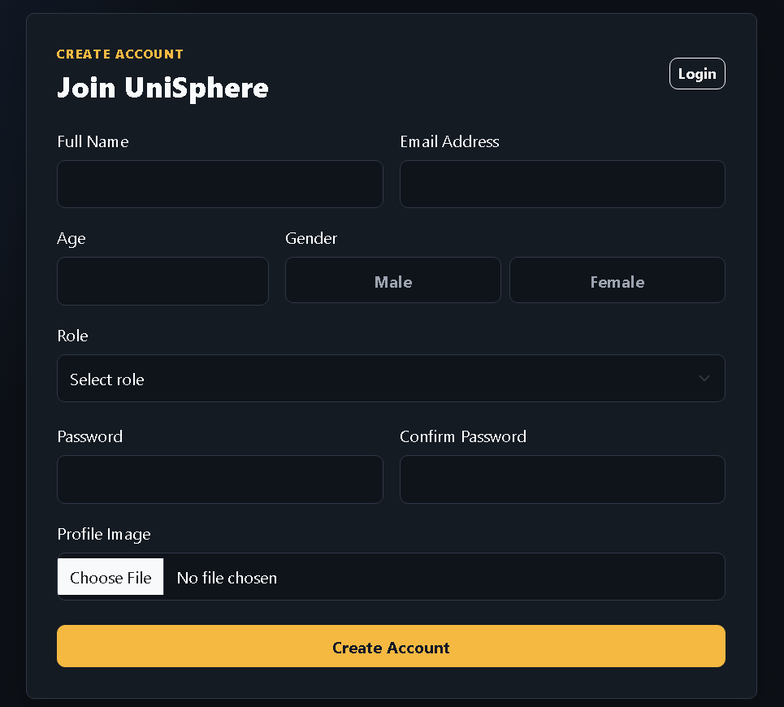
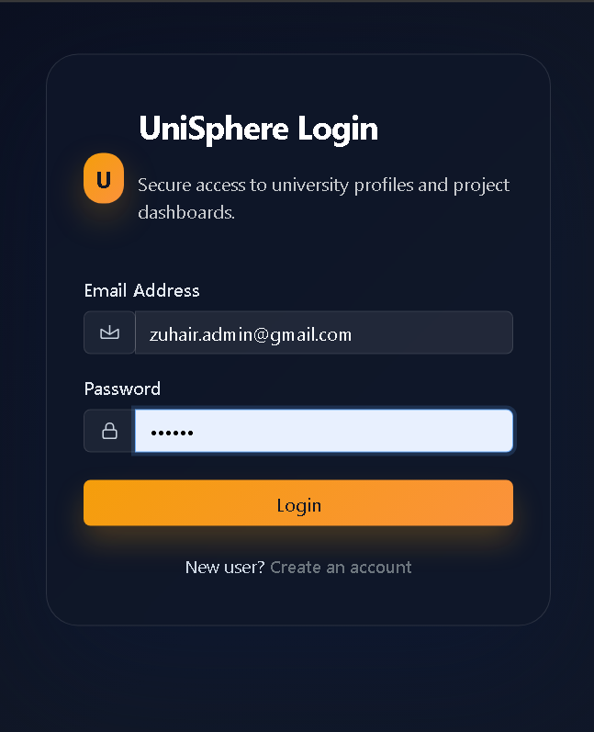
Authentication & Enrollment (Login & Signup)
NNNNNNNNNN
Admin login gateway with session security and multi-field user enrollment form."

Slide 16
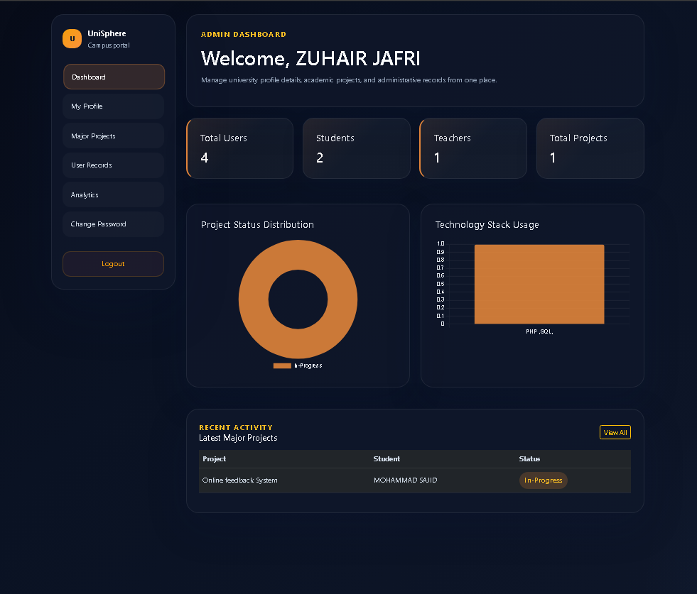
Administrative Command Center
REAL-time analytical counters for Students, Teachers, and Projects.
Interactive sidebar for seamless navigation.

Slide 17
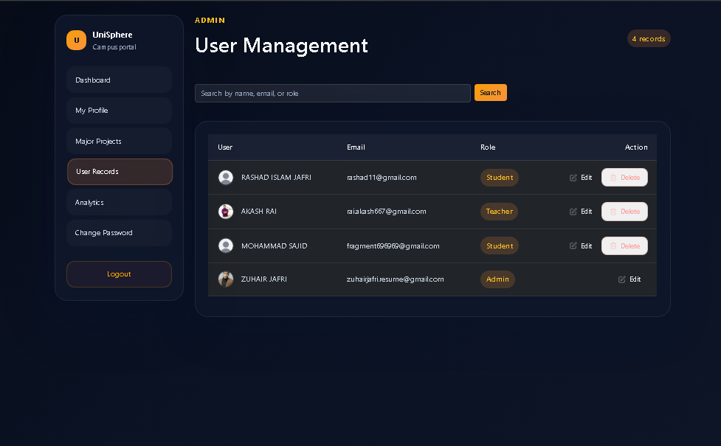
User Management & Data Logic
Dynamic data table with SQL-based filtering and custom pagination logic."

Slide 18
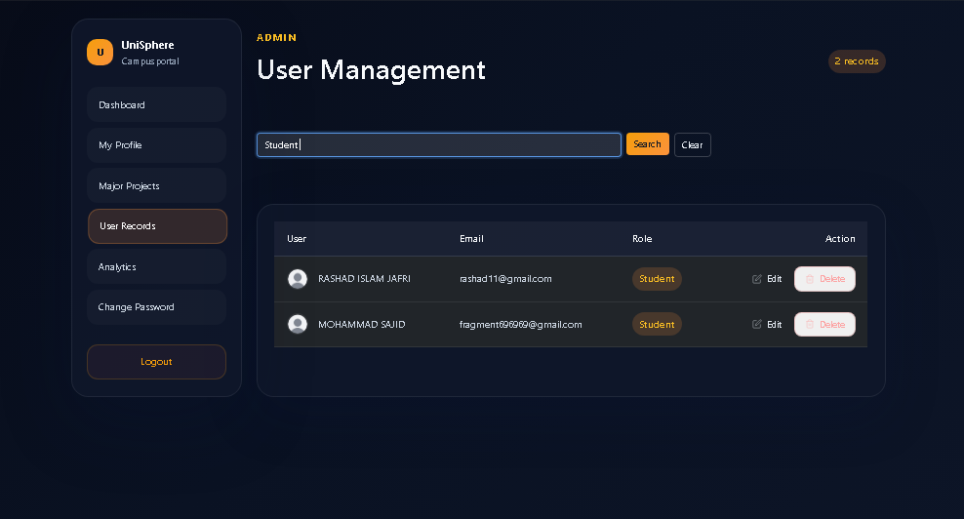
Records Management & Search
Search and filter Records

Slide 19
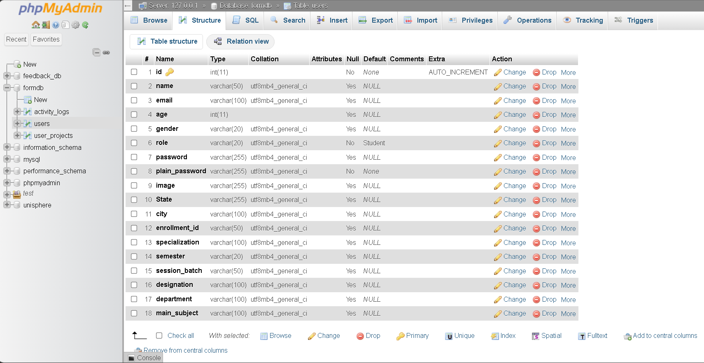
Backend & Technical Infrastructure
phpMyAdmin

Slide 20
CHALLENGES & KEY LEARNINGS
Overcame complex structural matrix mapping obstacles when syncing 40+ independent dynamic data inputs.
Mastered professional industry "Clean Code" principles, documentation habits, and scalable folder organization.
Gained critical problem-solving skills by debugging runtime environment errors using server log diagnostics.

Slide 21
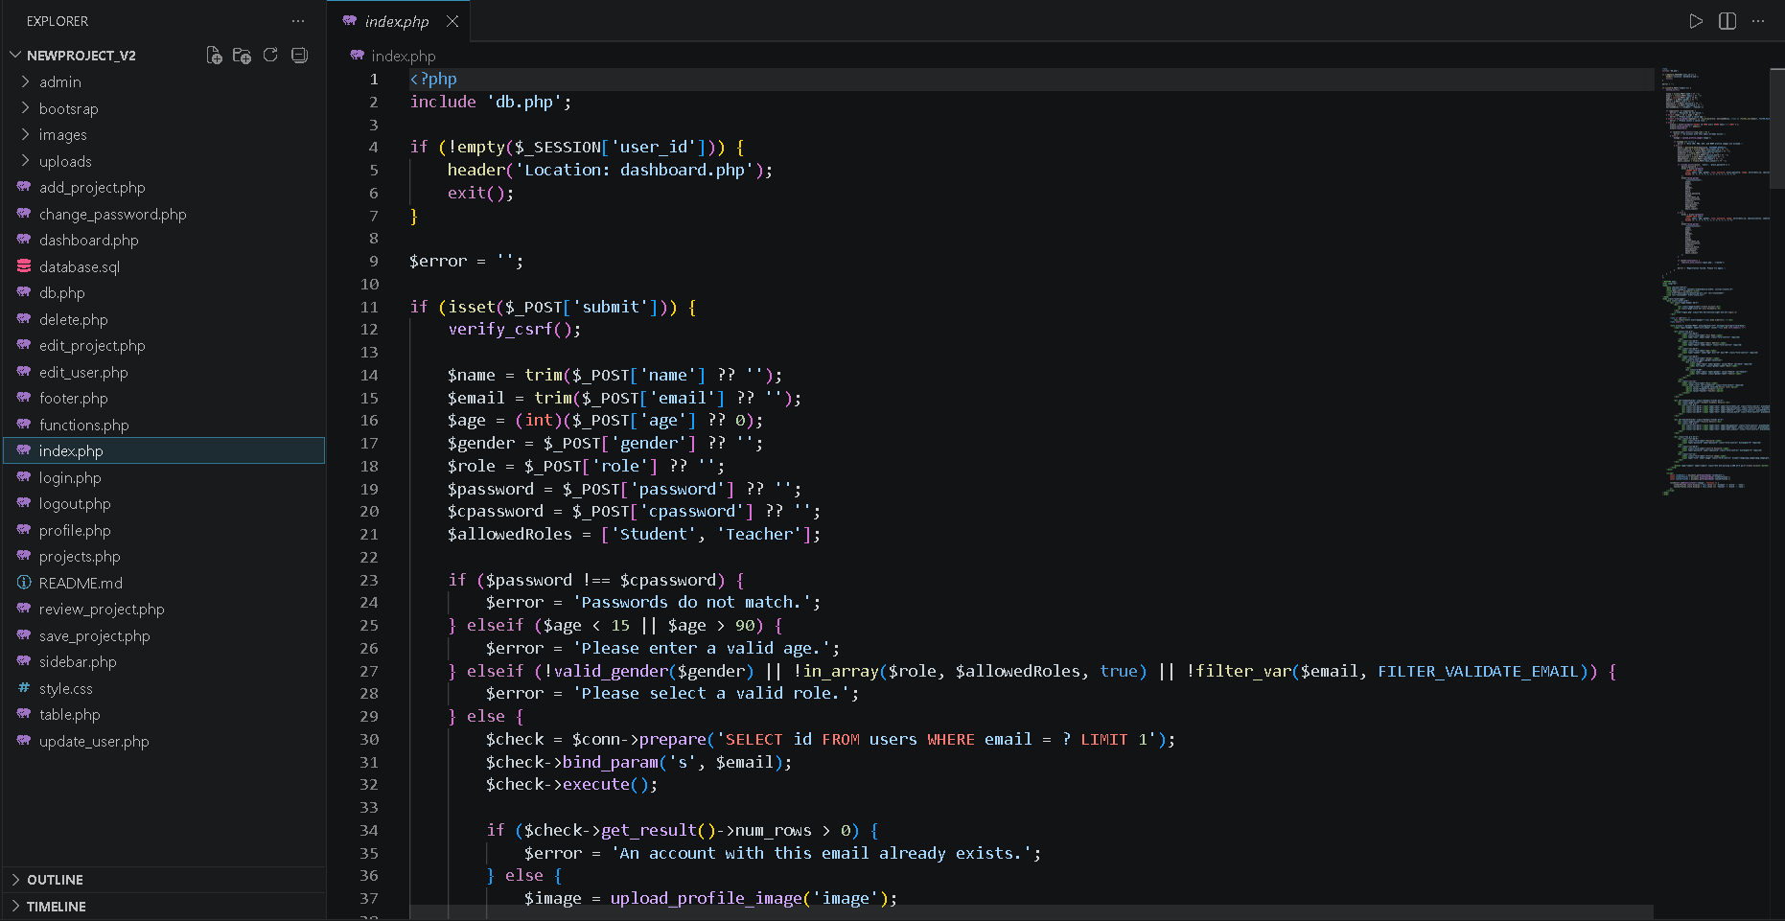
modular PHP directory architecture.
VS Code

Slide 22
CONCLUSION
Successfully delivered a functional, feature-rich, and scalable full-stack enterprise software prototype.
Transformed basic academic development skills into professional software engineering practices.
Ready to deploy and expand this modular ecosystem for global institutional tracking requirements.

